Slide 1
E-Commerce Data Analysis
SHOP
Presented by: Avram Darius
Last Updated: 03.10.2024

Slide 2
Presentation Contents
PAY
01
Objective / Introduction
Figuring out the problem and the objectives
02
Data
Using data to draw factual conclusions
03
Decisions
Using data to provide information that can be used for business decisions
04
Ending Thoughts
Ending thoughts and information

Slide 3
Introduction
When I was approached by your company, I was tasked with finding out ways to optimize your business and use the dataset provided to give suggestions of actions that need to be taken for the firm to become more profitable.
Mas
Venus

Slide 4
The Analysis
Using your dataset, I had information about CustomerID, ProductID, Quantity, Price, TransactionDate, PaymentMethod, StoreLocation, ProductCategory, DiscountApplied(%), and TotalAmount.
I analyzed every single one of them to identify possible problems and inform shareholders/managers of what works and what doesn’t.

Slide 5
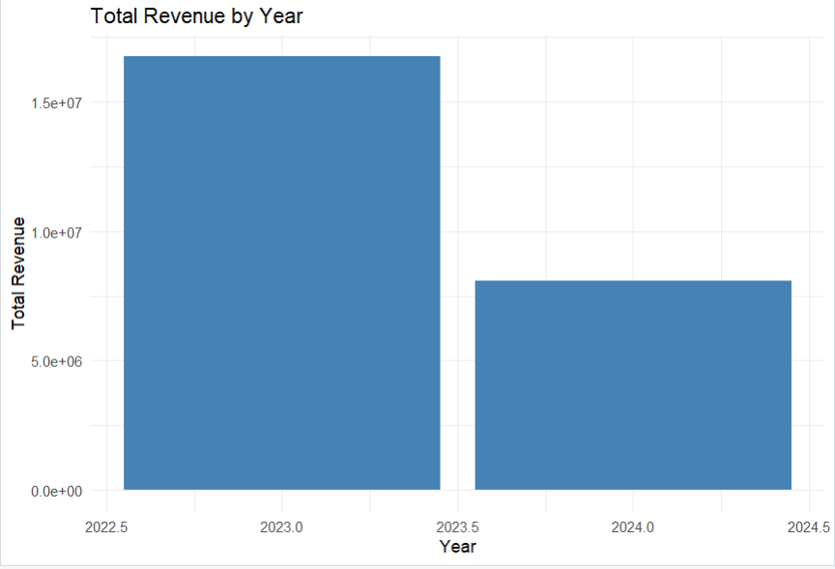
Analysis 1: 2023 v 2024
The first major problem of the firm is that the revenue decreased by around 50% in just a year!
This matter will require a lot of analysis so that we can find the root of the problem.

Slide 6
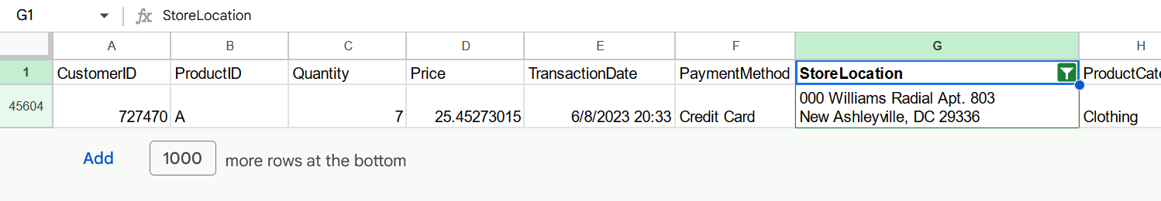
Analysis 2: store location issue
As the first step, I tried to compare the stores performance in 2023 vs 2024. Here I encountered a problem, the “store location” never repeats!
Instead of store locations, I think that these are customers addresses but the column name was mislabeled. This is just 1 example

Slide 7
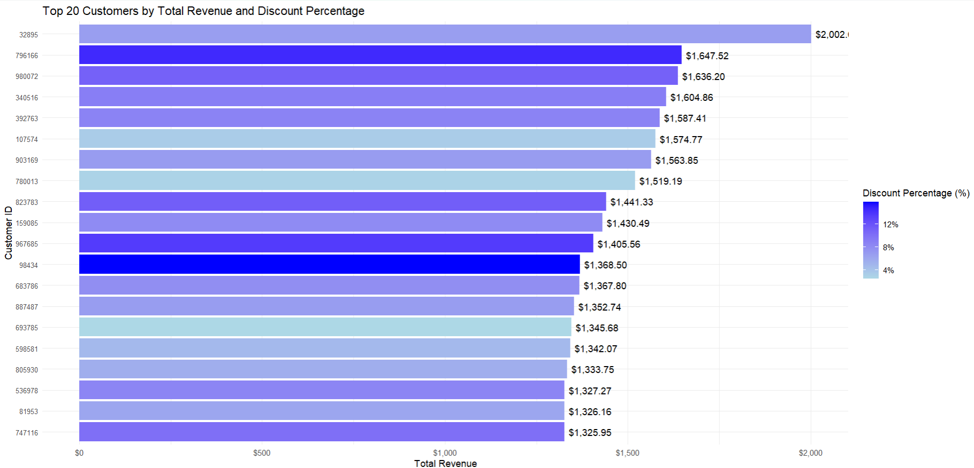
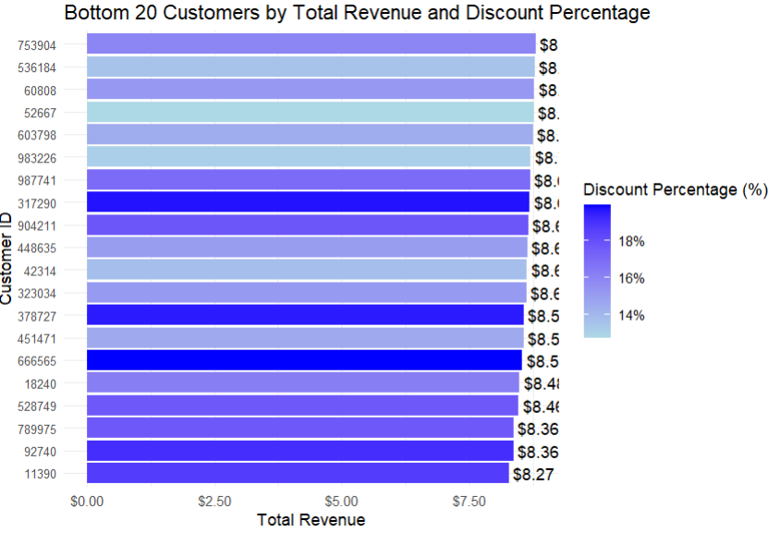
Analysis 3: Looking for possible problems
I thought of checking the discount, see how it affected the revenue.
The top performing had a lower discount on average, while the bottom ones had a higher discount.
The strategy used is probably trying to attract people who spend less with bigger discounts but that doesn’t seem to work that well.
Asking people to submit what they liked and didn’t like about the website could help restructure the strategy
SERVICES

Slide 8
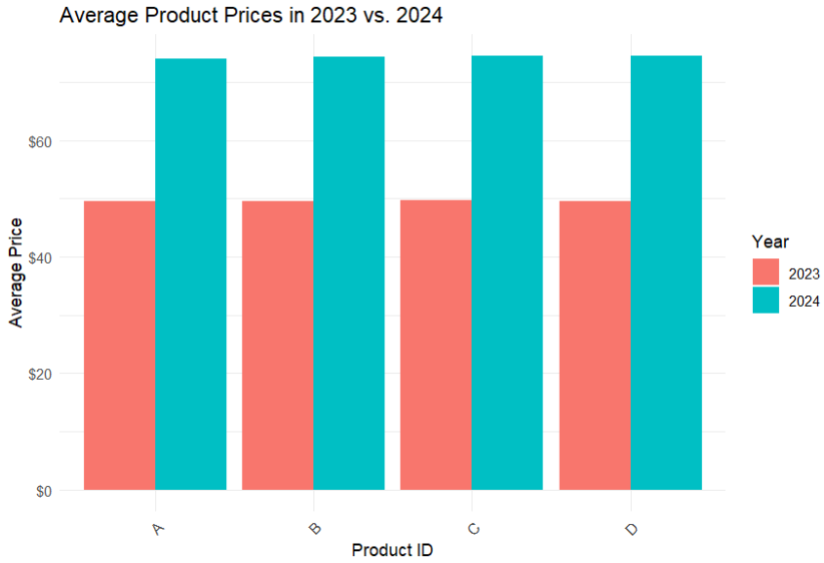
Analysis 4: The most relevant data
15%
5%
15%
After checking every possible reason for the revenue decrease, the only other significant finding was the massive product price increase.
The price almost doubled, this might be the reason why customers haven’t been buying much products, this type of price increase is too big and too sudden for most people.

Slide 9
Analysis Conclusions
Based on the findings in the previous slides the most urgent matter is trying to lower the price.
This could be achieved by simply lowering the price (if possible), if not I would suggest talking to the supplier/s and trying to get a better price, company restructure or even looking for different suppliers.
And discounts seem to play some part too, however just having a big/low discount doesn’t seem to be doing much so I would recommend doing a loyalty program that could give bigger discounts based on how much the user would buy.
If you want to take a look at further analysis, such as top customers, do let me know and I can send over lists, or you can find them in the project documentation!

Slide 10
Thank you for your attention
Do you have any questions?
avram.dariusalexandru25@gmail.com
+0724086078
Website: startling-cat-922f3d.netlify.app
Documentation for project:https://docs.google.com/document/d/1wXvvf5jOTckigDKzs47aOFOEfovtamGYSQk5IetYdck/edit?usp=sharing

